Slide 1

Manu Benny
Rajesh Bhandari
Teja Sri Lakshmi Balaji Bokka Madeleine Breitkreutz
Atif Harshad
Jannis Römermann
27 April 2023
Team C-rious
Milestone 2

Slide 2
2/13
Content
Project Plan by Weeks
Project Plan by Content
Lessons Learned

Slide 3
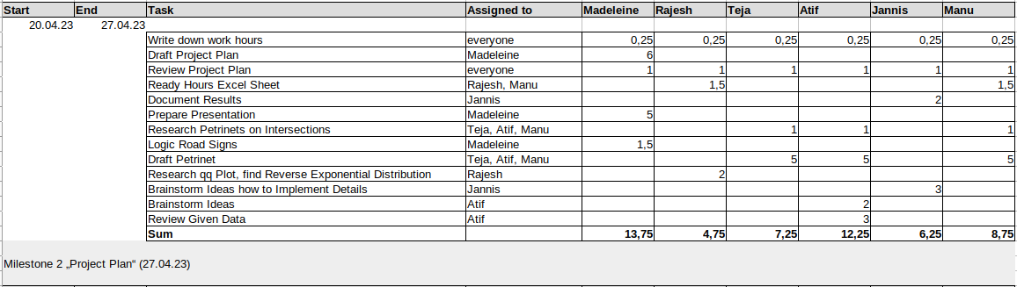
3/13
Project Plan by Weeks
Lorem
Id volutpat lacus laoreet non curabitur gravida arcu. Felis bibendum ut tristique et egestas quis ipsum suspendisse. Quam viverra orci sagittis eu. Risus commodo viverra maecenas accumsan lacus. Sit amet est placerat in egestas. Semper auctor neque vitae tempus quam pellentesque

Slide 4
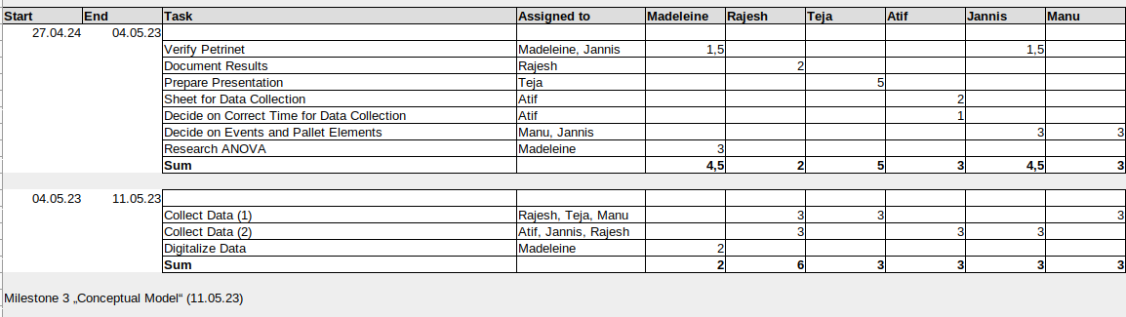
4/13
Project Plan by Weeks
Lorem
Id volutpat lacus laoreet non curabitur gravida arcu. Felis bibendum ut tristique et egestas quis ipsum suspendisse. Quam viverra orci sagittis eu. Risus commodo viverra maecenas accumsan lacus. Sit amet est placerat in egestas. Semper auctor neque vitae tempus quam pellentesque

Slide 5
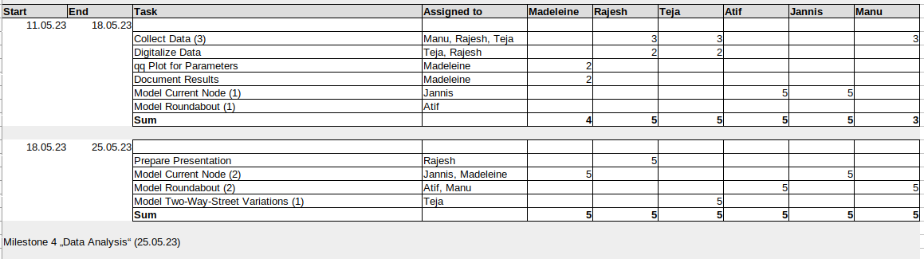
5/13
Project Plan by Weeks
Lorem
Id volutpat lacus laoreet non curabitur gravida arcu. Felis bibendum ut tristique et egestas quis ipsum suspendisse. Quam viverra orci sagittis eu. Risus commodo viverra maecenas accumsan lacus. Sit amet est placerat in egestas. Semper auctor neque vitae tempus quam pellentesque

Slide 6
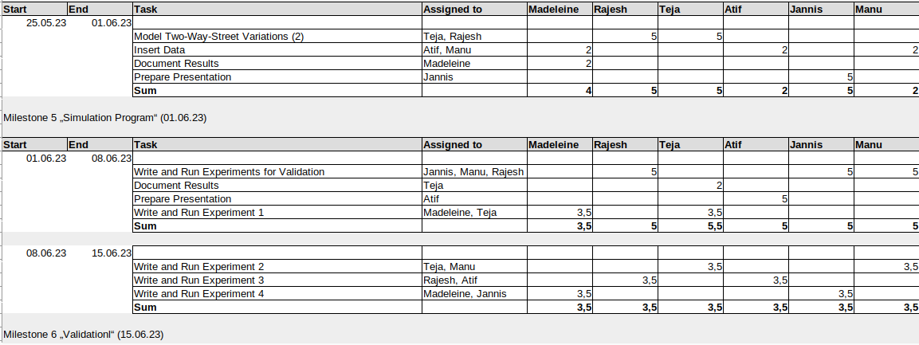
6/13
Project Plan by Weeks
Lorem
Id volutpat lacus laoreet non curabitur gravida arcu. Felis bibendum ut tristique et egestas quis ipsum suspendisse. Quam viverra orci sagittis eu. Risus commodo viverra maecenas accumsan lacus. Sit amet est placerat in egestas. Semper auctor neque vitae tempus quam pellentesque

Slide 7
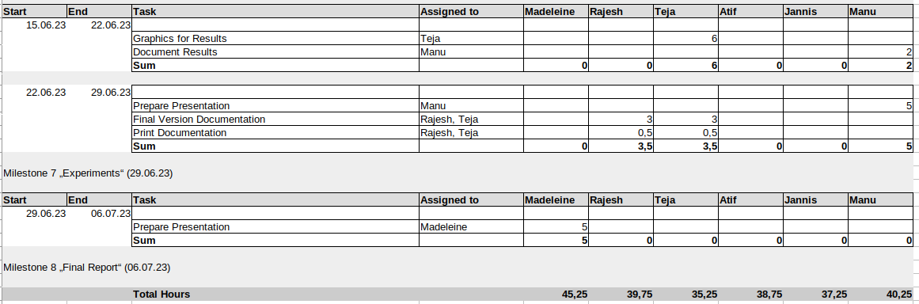
7/13
Project Plan by Weeks
Lorem
Id volutpat lacus laoreet non curabitur gravida arcu. Felis bibendum ut tristique et egestas quis ipsum suspendisse. Quam viverra orci sagittis eu. Risus commodo viverra maecenas accumsan lacus. Sit amet est placerat in egestas. Semper auctor neque vitae tempus quam pellentesque

Slide 8
8/13
Project Plan by Content
To Note:
Total hours available: 600
Total hours needed according to info on the website: 330
Total hours estimated: 357 (Teammeetings included)
Presentations do not count into hours
Duration pools hours

Slide 9
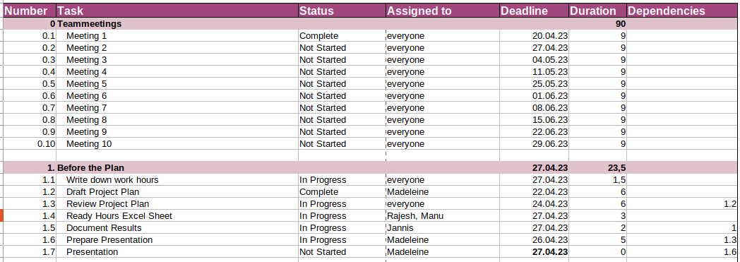
9/13
Project Plan by Content
To Note:
Total hours available: 600
Total hours needed according to info on the website: 330
Total hours estimated: 357 (Teammeetings included)
Presentations do not count into hours

Slide 10
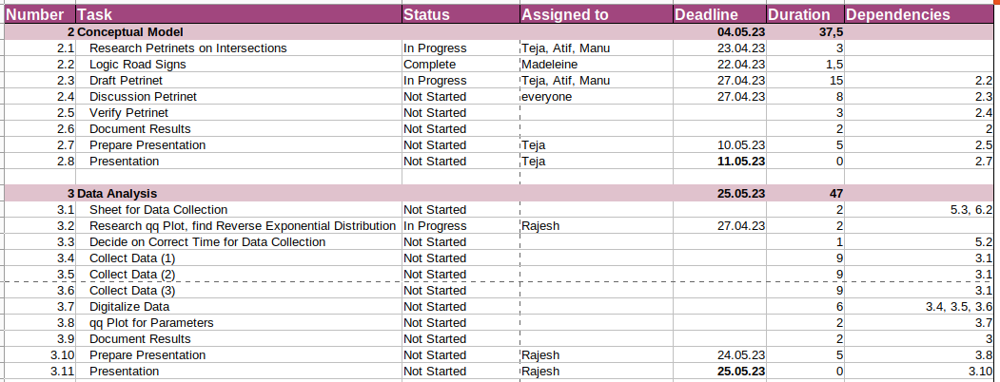
10/13
Project Plan by Content
To Note:
Total hours available: 600
Total hours needed according to info on the website: 330
Total hours estimated: 357 (Teammeetings included)
Presentations do not count into hours

Slide 11
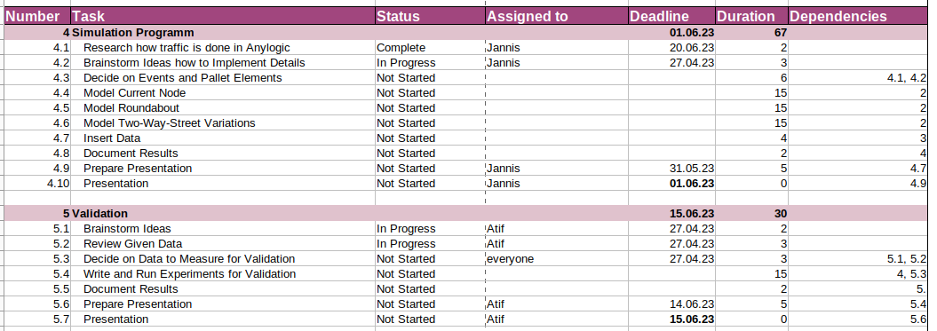
11/13
Project Plan by Content
To Note:
Total hours available: 600
Total hours needed according to info on the website: 330
Total hours estimated: 357 (Teammeetings included)
Presentations do not count into hours

Slide 12
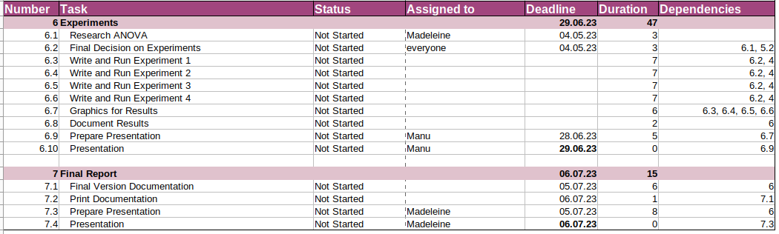
12/13
Project Plan by Content
To Note:
Total hours available: 600
Total hours needed according to info on the website: 330
Total hours estimated: 357 (Teammeetings included)
Presentations do not count into hours

Slide 13
13/13
Lessons Learned
Without a plan we were way off in estimating what we have to do
Different kind of plans are good for different things
There is no such thing as being sure
The project seem less overwhelming

